Slide 1



Analysis of COVID-19 data stored in AWS
Big Data Course

Slide 2

Analysis of COVID-19 data stored in AWS
Unit 1. Introduction
Unit 2. Project execution
Unit 3. Results
Samsung Innovation Campus
‹#›

Slide 3
Analysis of COVID-19 data stored in AWS
Unit 1. Introduction
Samsung Innovation Campus
‹#›

Slide 4
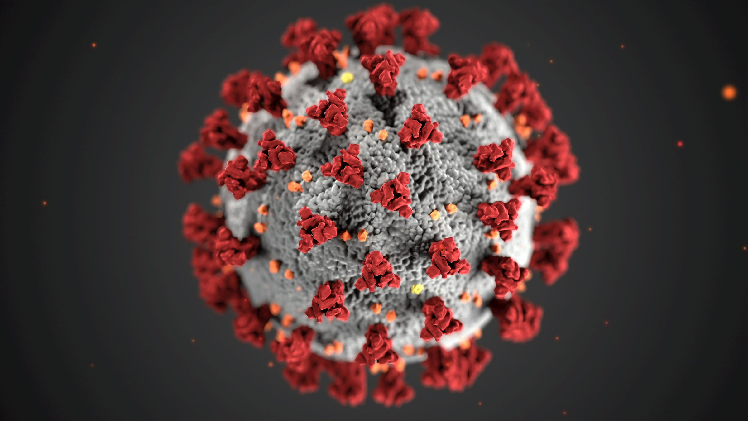
Unit 1. Introduction
1.2. Background Information
The COVID-19 pandemic has significantly affected global well-being.
This pandemic has dramatically changed the world.
Samsung Innovation Campus
‹#›

Slide 5

Unit 1. Introduction
1.3. Objective
By analyzing the covid-19 data, we are able to discover and understand deeply about many aspects of the pandemic.
Samsung Innovation Campus
‹#›

Slide 6

Unit 1. Introduction
1.4. Milestones
Researching the topic
Following the tutorial
​Thinking and choosing the topic
​Selecting the dataset
Carrying on project
Samsung Innovation Campus
‹#›

Slide 7
Analysis of COVID-19 data stored in AWS
Unit 2. Project Execution
Samsung Innovation Campus
‹#›

Slide 8

Unit 2. Project Execution
2.1. Simulated Scenario Description
A situation where a national public health agency is facing a critical challenge.
There is a huge amount of data from many sources and formats that need to be processed.
To track the spread of the virus, monitor vaccination efforts, and identify regions at risk of outbreaks.
Samsung Innovation Campus
‹#›

Slide 9


Unit 2. Project Execution
2.2. Datasets Selection and Description
Choosing the dataset from the AWS blog, which was called “A public data lake for analysis of COVID-19 data”.
AWS
BLOG
Samsung Innovation Campus
‹#›

Slide 10
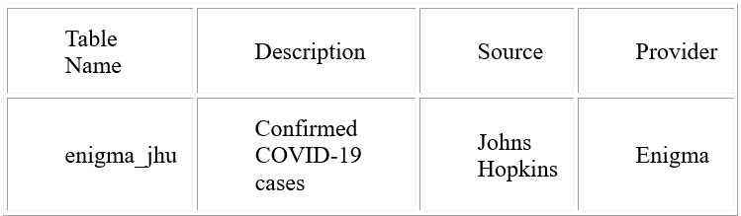
Unit 2. Project Execution
2.2. Datasets Selection and Description
Global Coronavirus (COVID-19) Data
Samsung Innovation Campus
‹#›

Slide 11
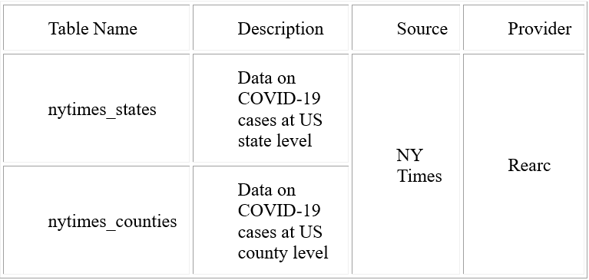
Unit 2. Project Execution
2.2. Datasets Selection and Description
Coronavirus (COVID-19) Data in the United States
Samsung Innovation Campus
‹#›

Slide 12
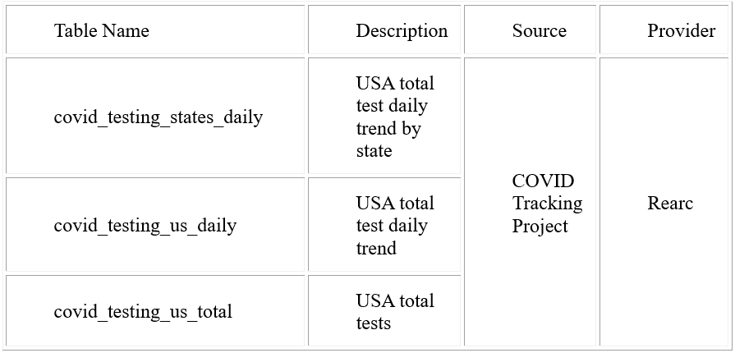
Unit 2. Project Execution
2.2. Datasets Selection and Description
Coronavirus Disease (COVID-19) Testing Data
Samsung Innovation Campus
‹#›

Slide 13
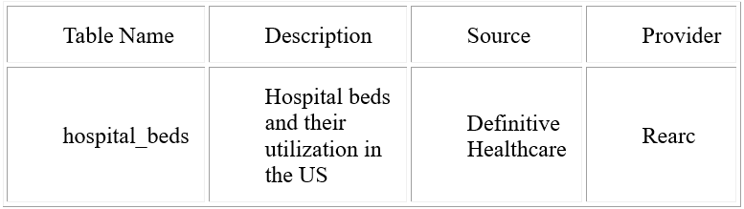
Unit 2. Project Execution
2.2. Datasets Selection and Description
USA Hospital Beds – COVID-19
Samsung Innovation Campus
‹#›

Slide 14
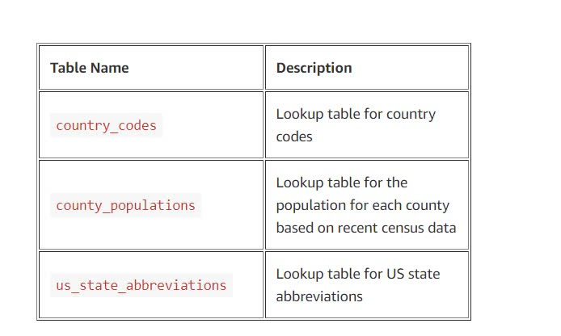
Unit 2. Project Execution
2.2. Datasets Selection and Description
​Lookup tables to support visualizations.
Samsung Innovation Campus
‹#›

Slide 15
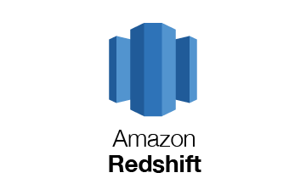





Unit 2. Project Execution
2.3. Data Ingestion Pipeline
Crawler
AWS Glue
Power BI
Amazon S3
Amazon Athena
Amazon Redshift
Data Pipeline
Visualization
Samsung Innovation Campus
‹#›

Slide 16
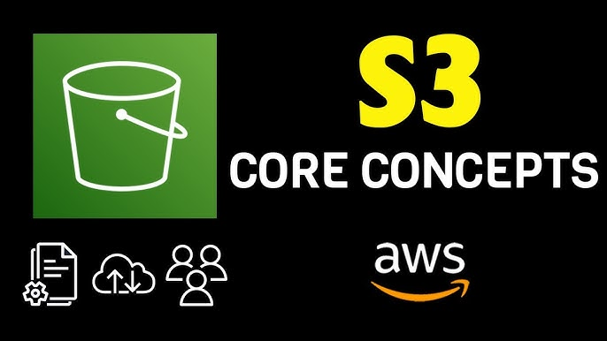
Unit 2. Project Execution
2.3. Data Transformation Processing
Step 1: We upload data from the source collected from the Internet to Amazon S3.
Samsung Innovation Campus
‹#›

Slide 17

Unit 2. Project Execution
2.3. Data Transformation Processing
Step 1: We upload data from the source collected from the Internet to Amazon S3.
Step 2: We analyze data using AWS Athena.
Samsung Innovation Campus
‹#›

Slide 18
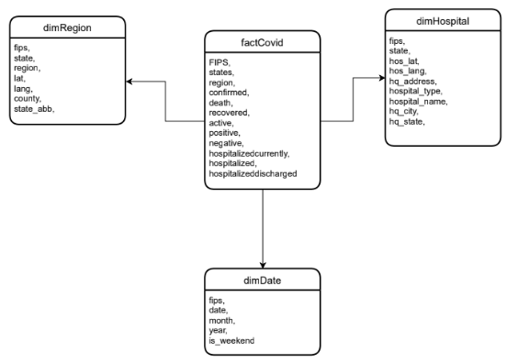
Unit 2. Project Execution
2.3. Data Transformation Processing
Before we executed 3 steps, we will obtain 4 tables: factCovid, dimRegion, dimHospital, and dimDate
Samsung Innovation Campus
‹#›

Slide 19

Unit 2. Project Execution
2.3. Data Transformation Processing
Step 1: We upload data from the source collected from the Internet to Amazon S3.
Step 2: We analyze data using AWS Athena.
Step 3: Using OLAP to minimize data.
Step 4: ETL in Python.
Samsung Innovation Campus
‹#›

Slide 20

Unit 2. Project Execution
2.3. Data Transformation Processing
Step 1: We upload data from the source collected from the Internet to Amazon S3.
Step 2: We analyze data using AWS Athena.
Step 3: Using OLAP to minimize data.
Step 4: ETL in Python.
Step 5: Save results to S3.
Samsung Innovation Campus
‹#›

Slide 21
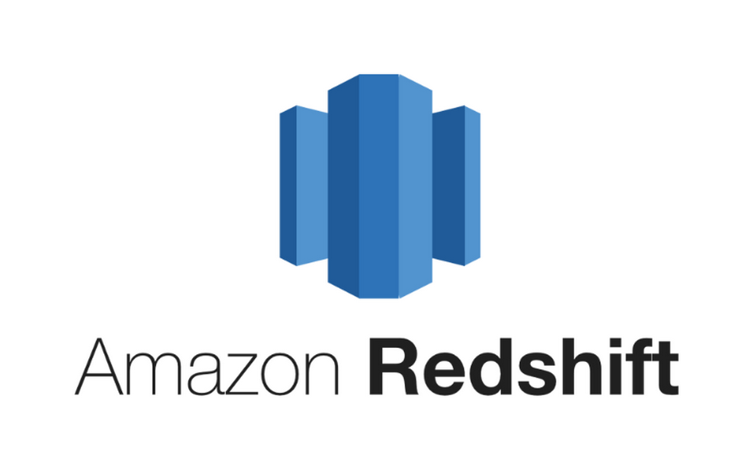
Unit 2. Project Execution
2.3. Data Transformation Processing
Step 1: We upload data from the source collected from the Internet to Amazon S3.
Step 2: We analyze data using AWS Athena.
Step 3: Using OLAP to minimize data.
Step 4: ETL in Python.
Step 5: Save results to S3.
Step 6: Build tables on Redshift.
Samsung Innovation Campus
‹#›

Slide 22
Unit 2. Project Execution
2.3. Data Transformation Processing
Step 1: We upload data from the source collected from the Internet to Amazon S3.
Step 2: We analyze data using AWS Athena.
Step 3: Using OLAP to minimize data.
Step 4: ETL in Python.
Step 5: Save results to S3.
Step 6: Build tables on Redshift.
Step 7: Copy data on Redshift.
Samsung Innovation Campus
‹#›

Slide 23

Unit 2. Project Execution
2.3. Data Transformation Processing
Step 1: We upload data from the source collected from the Internet to Amazon S3.
Step 2: We analyze data using AWS Athena.
Step 3: Using OLAP to minimize data.
Step 4: ETL in Python.
Step 5: Save results to S3.
Step 6: Build tables on Redshift.
Step 7: Copy data on Redshift.
Step 8: Visualization on Power BI.
Samsung Innovation Campus
‹#›

Slide 24
Analysis of COVID-19 data stored in AWS
Unit 3. Results
Samsung Innovation Campus
‹#›

Slide 25
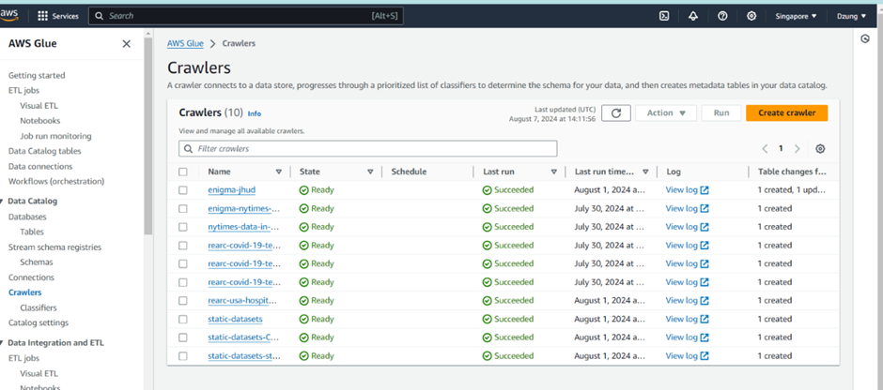
Unit 3. Results
3.1. Data Ingestion
Crawler
Samsung Innovation Campus
‹#›

Slide 26
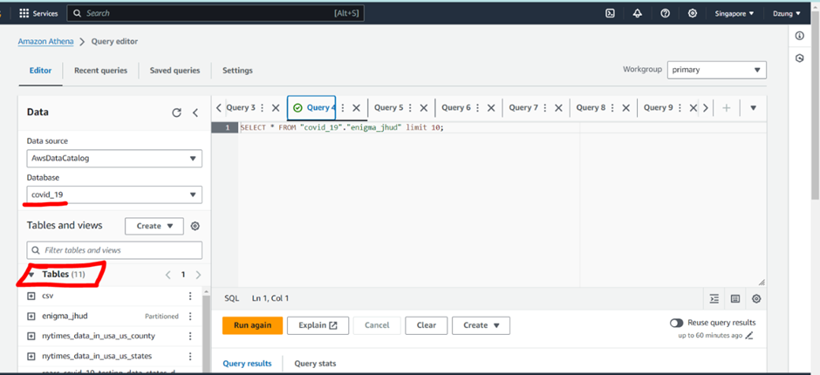
Unit 3. Results
3.1. Data Ingestion
Data on Athena
Samsung Innovation Campus
‹#›

Slide 27
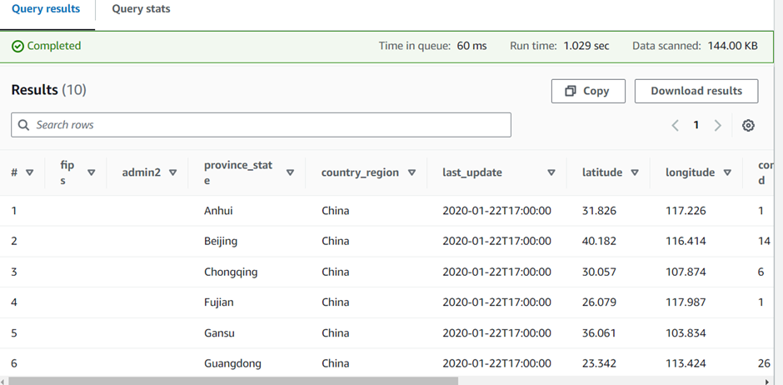
Unit 3. Results
3.1. Data Ingestion
Query
Samsung Innovation Campus
‹#›

Slide 28
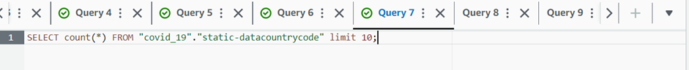
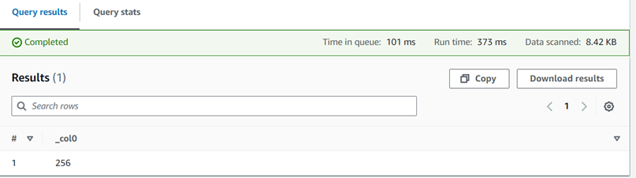
Unit 3. Results
3.1. Data Ingestion
Query: Count the data in the static-datacountrycode table
Samsung Innovation Campus
‹#›

Slide 29
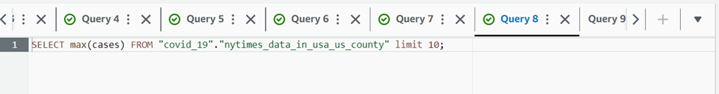
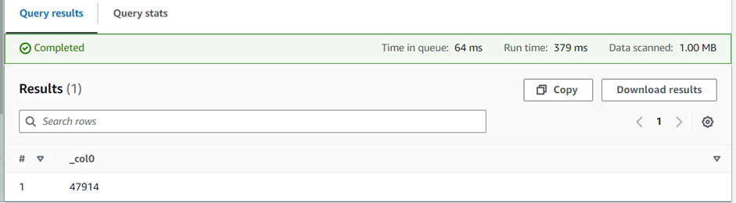
Unit 3. Results
3.1. Data Ingestion
Query: Highest number of cases in nytimes_data_in_usa_us_county table
Samsung Innovation Campus
‹#›

Slide 30
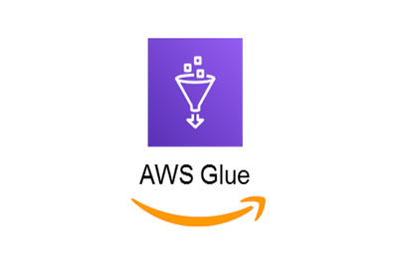
Unit 3. Results
3.2. Data Transformation
AWS Glue: Executing the data transformation and preparation pipeline for loading into Amazon Redshift.
Samsung Innovation Campus
‹#›

Slide 31
Unit 3. Results
3.2. Data Transformation
Amazon Redshift: Cloud data warehouse for fast analytics on large datasets. Stores prepared data from AWS Glue for querying and reporting.
Samsung Innovation Campus
‹#›

Slide 32
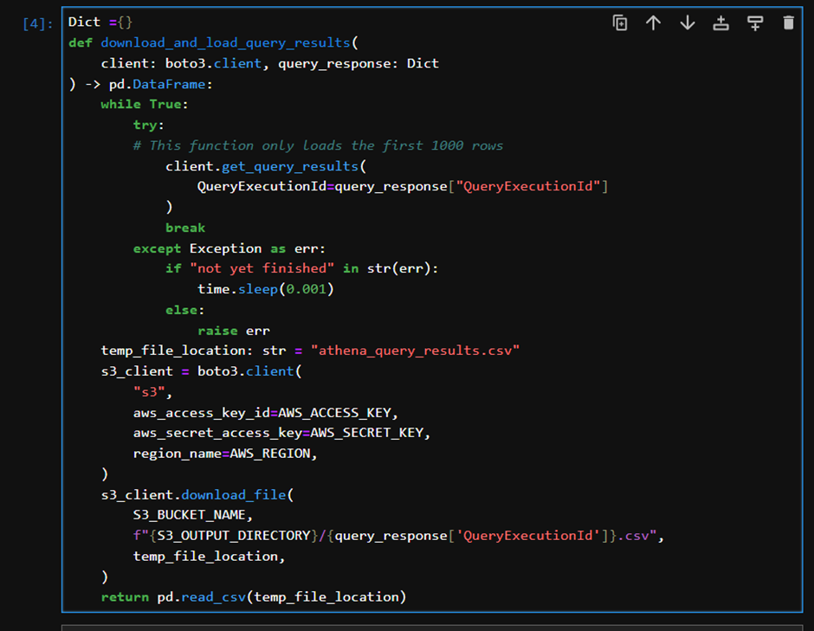
Unit 3. Results
3.2. Data Transformation
Create a function to load query results from Amazon Athena into a pandas DataFrame.
Samsung Innovation Campus
‹#›

Slide 33
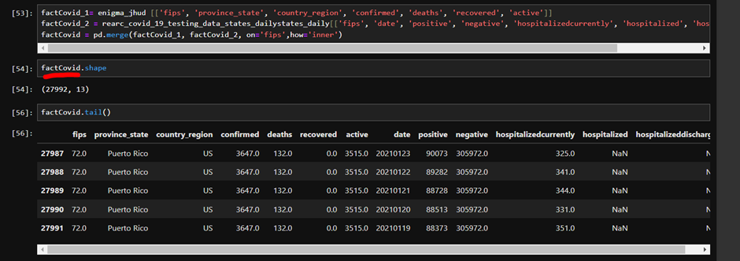
Unit 3. Results
3.2. Data Transformation
After saving the data in the dataFrame, we create the tables factCovid, dimHostpital, dimDate, and dimRegion.
Samsung Innovation Campus
‹#›

Slide 34
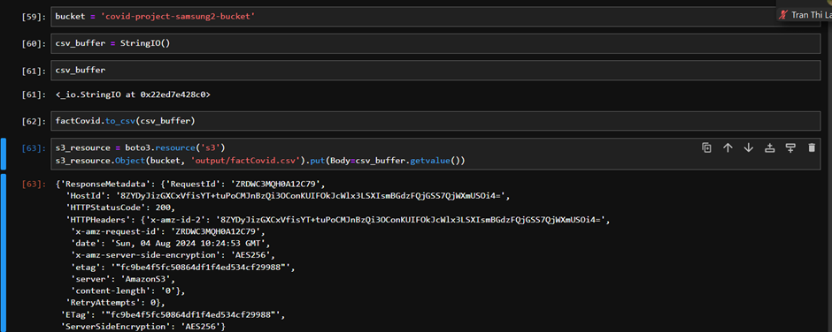
Unit 3. Results
3.2. Data Transformation
Save the dataFrame factCovid into the file factCovid.csv in the “output” folder.
Samsung Innovation Campus
‹#›

Slide 35
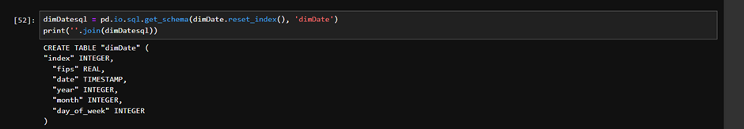
Unit 3. Results
3.2. Data Transformation
Create data frames on Redshift
Samsung Innovation Campus
‹#›

Slide 36
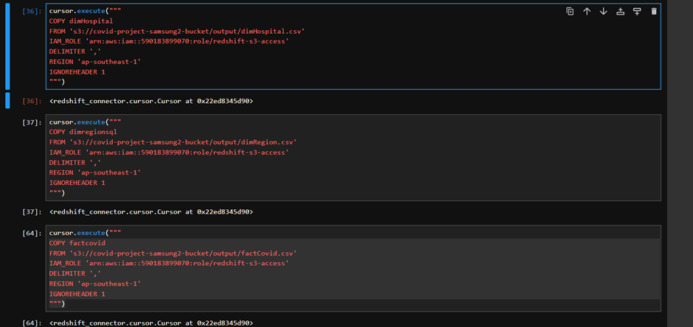
Unit 3. Results
3.2. Data Transformation
After setting up the frame on Redshift, we copy data from the output files (such as factCovid.csv, dimDate.csv, etc.) into the Redshift database
Samsung Innovation Campus
‹#›

Slide 37
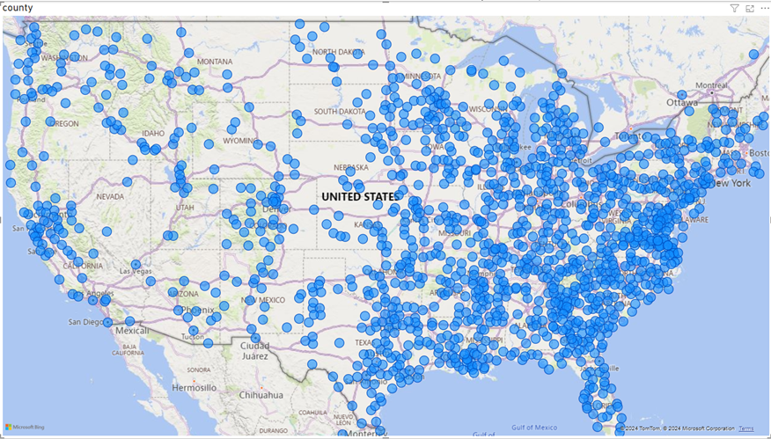
Unit 3. Results
3.2. Data Visualization
Map of distribution of COVID-19 cases across the United States
Samsung Innovation Campus
‹#›

Slide 38
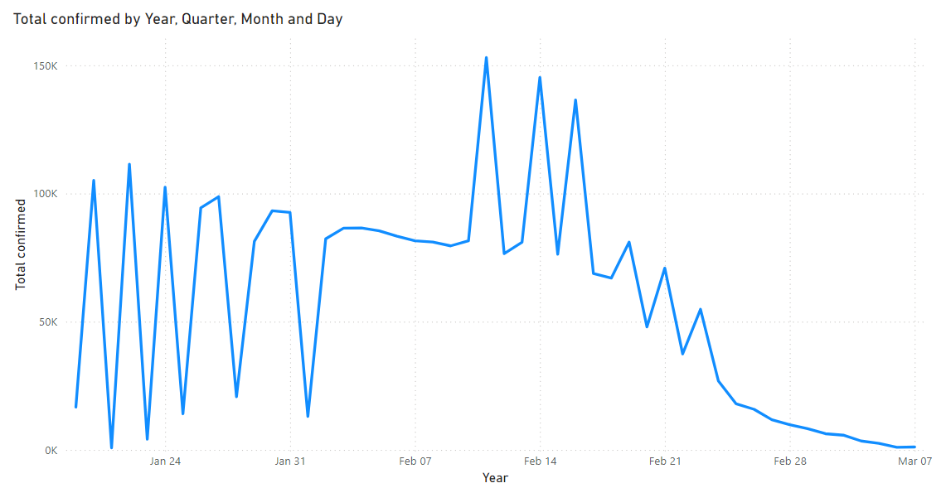
Unit 3. Results
3.2. Data Visualization
Line chart showing the world's number of covid-19 infections over time from January 19 to March 7
Samsung Innovation Campus
‹#›

Slide 39
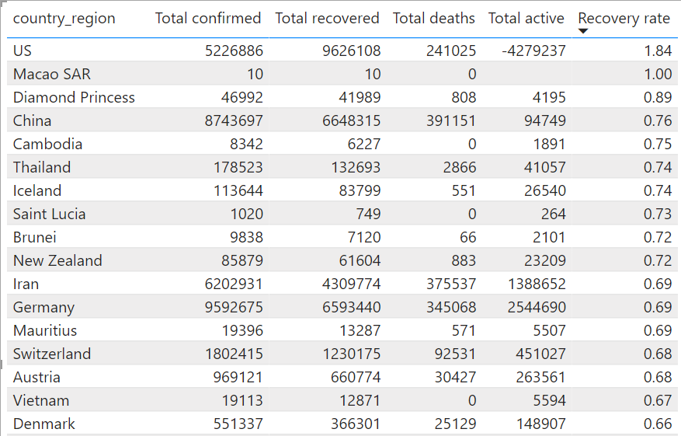
Unit 3. Results
3.2. Data Visualization
The table shows the recovery rate of COVID-19 cases in the world over time from January 19 to March 7
Samsung Innovation Campus
‹#›

Slide 40
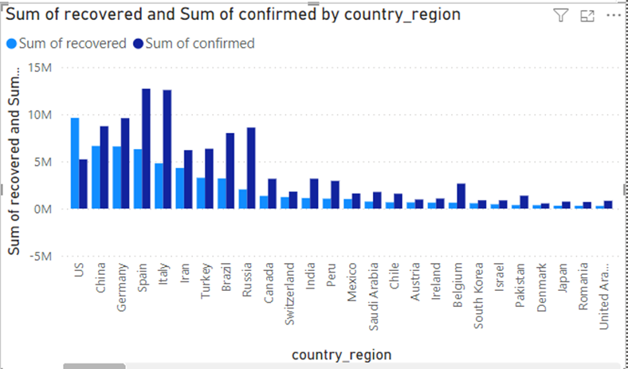
Unit 3. Results
3.2. Data Visualization
Bar chart showing total COVID-19 infections of countries around the world over time from January 19 to March 7
Samsung Innovation Campus
‹#›

Slide 41
Analysis of COVID-19 data stored in AWS
Thanks for watching!!!
Samsung Innovation Campus
‹#›

Slide 42



ⓒ2023 SAMSUNG. All rights reserved.
Samsung Electronics Corporate Citizenship Office holds the copyright of book.
This book is a literary property protected by copyright law so reprint and reproduction without permission are prohibited.
To use this book other than the curriculum of Samsung Innovation Campus or to use the entire or part of this book, you must receive written consent from copyright holder.

